Slide 1
Battleship
McKenzie Swindler | Mykaela Moore | Joy Walgren

Slide 2
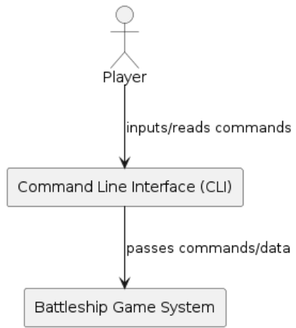
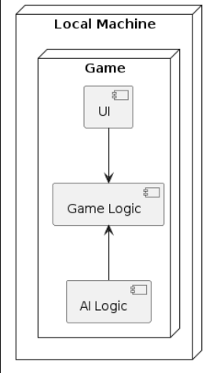
Context
Physical

Slide 3
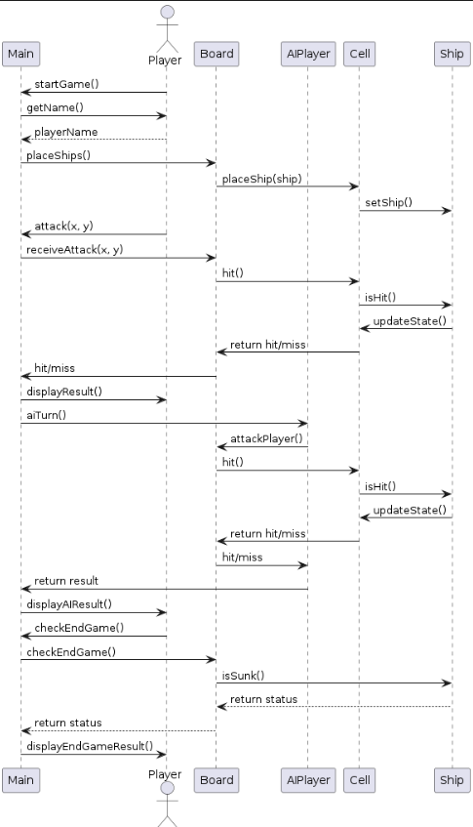
Process

Slide 4
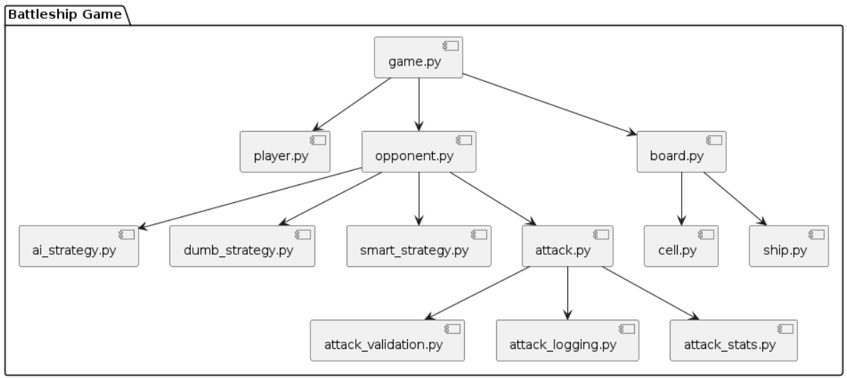
Development

Slide 5
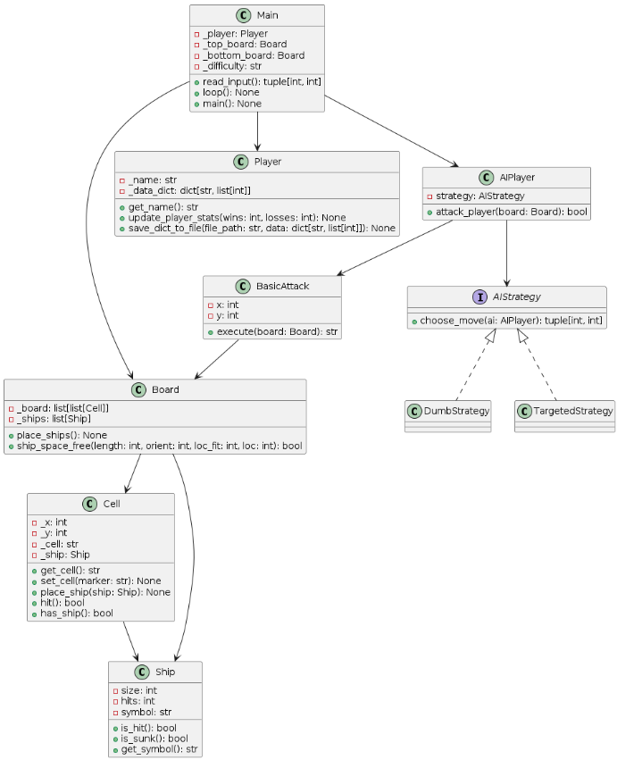
Logical

Slide 6
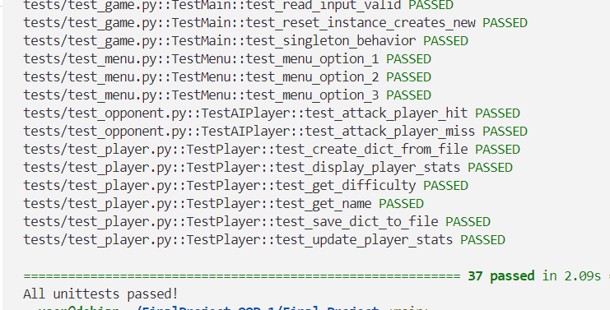
Tests
Classes
A total of 9 test classes
We had 37 test cases
We each tested each others code using unittest, hypothesis, and mocking and patching
A total of 16 classes
McKenzie: 5.5 Classes
Mykaela: 7 Classes
Joy: 3.5 Classes

Slide 7
Design Patterns
Singleton
Strategy
Decorator
The singleton pattern was used to ensure the manager class is only called once.
The strategy design pattern was used for the AI, opponent, files. This made most sense since we had two difficulty levels and the AI decides which strategy to do based on the difficulty level.
The decorator pattern was used for the attack method. Easier testing, separation and extension of functions based on main attack.

Slide 8
Takeaways

Slide 9
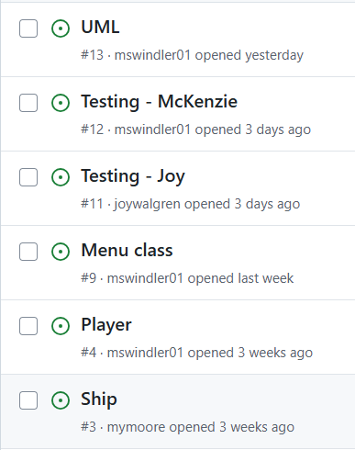
Software Management
For each class we made we would first create a new issue in Github so that we could create a new branch based on it

Slide 10
Questions?

